Slide 1
CSE231 – Digital Logic Design
Multiplexers and Demultiplexers

Slide 2
Multiplexers

Slide 3
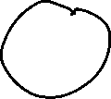



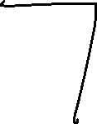




Multiplexer
A multiplexer switches (or routes) data from 2^{N} inputs to one output, where N is the number of select (or control) inputs.
A multiplexer (mux) is a digital switch.

Slide 4
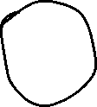

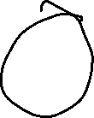




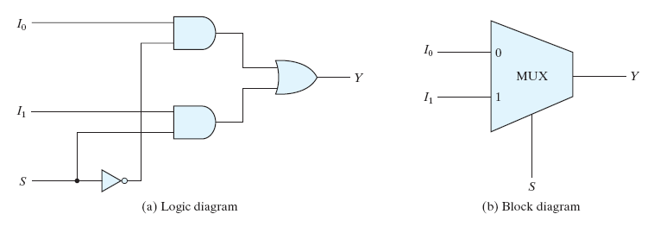
Multiplexer: 2-to-1
S = 0 selects I₀
2 inputs
1 output
S = 1 selects I₁
1 select
Y = (I₀.s') + (I₁.s)

Slide 5

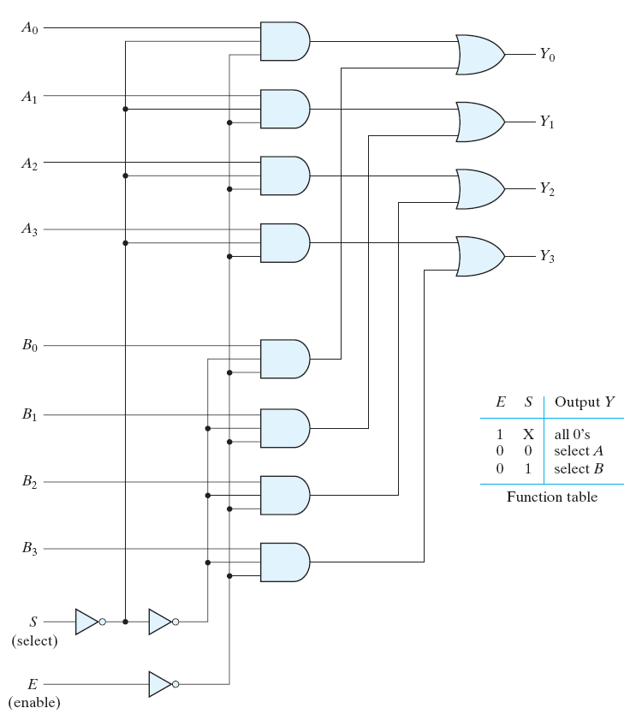









Multiplexer: 2-to-1 with Enable

Slide 6




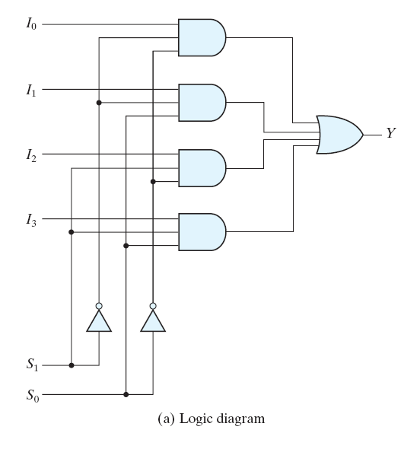

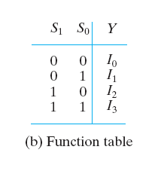
Multiplexer: 4-to-1
Two select signals
Y = (I₀.s₁'s₀') + (I₁.s₁'s₀) + (I₂.s₁s₀') + (I₃.s₁s₀)

Slide 7



Slide 8
Multiplexers
Designing Logic Circuits
using Multiplexers

Slide 9
Mux: Designing Logic Circuits
Each row in a Truth Table corresponds to a minterm
  N-input Truth Table
Each minterm can be mapped to a multiplexer input
  N-input Multiplexer
For each row in the Truth Table, where the output of the function is one (F = 1),
  Set the corresponding input of the multiplexer to 1

Slide 10
Mux: Desiging a Logic Circuit
Exercise:
Design a circuit, using a 4-to-1 Mux to realize the Boolean expression given below.
F_{X,Y} = Σm(0,2)

Slide 11
Multiplexers
Designing Logic Circuits
using Multiplexers more efficiently.

Slide 12
Mux: Designing Logic Circuits Efficiently
Each row in a Truth Table corresponds to a minterm
  N-input Truth Table
A product term of N-1 variables can be mapped to each of the multiplexer inputs
  (N-1)-input Multiplexer
For the rows in the Truth Table,
  Group N-1 highest order inputs into pairs
  Define the output of each pair using the N^{th} input

Slide 13
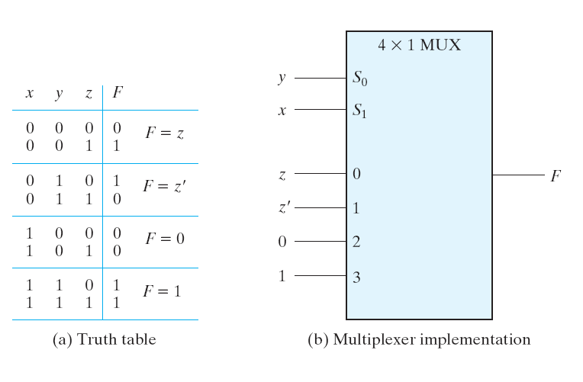





Mux: Designing a Logic Circuit

Slide 14


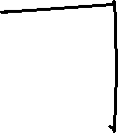
















Slide 15
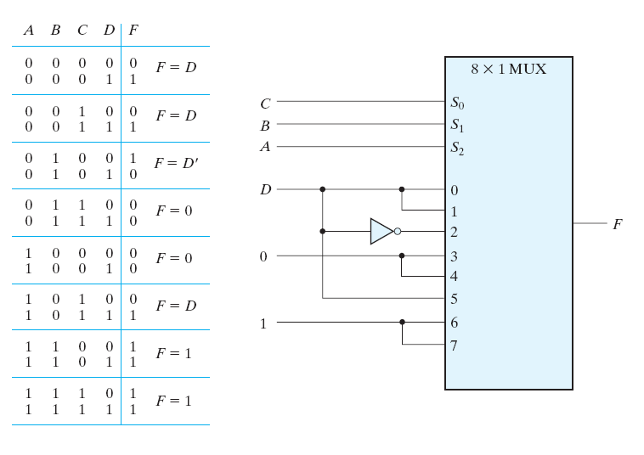
Mux: Designing a Logic Circuit

Slide 16
Mux: Designing a Logic Circuit
Exercise:
Design a circuit, using a 4-to-1 Mux to realize the Boolean expression given below.
F_{X,Y,Z} = Σm(1,2,3,6)

Slide 17
Demultiplexers

Slide 18
Demultiplexer
A demultiplexer switches (or routes) data from one input to 2^{N} outputs, where N is the number of select inputs.
A demultiplexer (mux) is also a digital switch.
A demultiplexer performs the opposite function of a multiplexer.

